Slide 1
Analysis of the popularity of reddit posts & Comments
By: Eva Tarr and Kyle Krawec
Notes:
Today we will be presenting the analysis we have done concerning popularity of reddit posts. Specifically, what makes a post popular and can we compartmentalize what makes something popular on social media sites.

Slide 2


Eva Tarr
Kyle Krawec

Slide 3
Definitions
Popularity
In the terms of this study, we will be defining popularity as the number of likes on a particular post or comment. The greater the number of likes the greater the popularity.
Reddit
Reddit is a social media platform where users can post texts, images and videos.
Sentiment
Sentiment of a post is the attributed emotional tone or attitude that is expressed by the author in the post. It determines if the post has a positive, neutral, or negative sentiment.
Notes:
To start off we will first define some of the terms we will be using throughout this presentation.
When talking about popularity within a digital space we quantify this based on the number of likes a post of comment receive.
All our tests will be done using data from the social media site Reddit, Reddit is a platform that users can post text, images and videos to. For the sake of this analysis, we only looked at text posts due to data constraints.
Sentiment, as we will be discussing it, refers to the tone or attitude associated with a certain comment. We will outline how this was achieved in each instance.

Slide 4
Main Research Questions:
Does the sentiment of a comment result in greater popularity?
Does the number of words in a comment result in greater popularity?
Do post who have more comments become more popular?
Does the time of creation of a post effect its popularity?
Does the number of comments on a post influence its popularity?
Which words are most frequently associated with a high, moderate, and low score?
Notes:
The main research questions we had were:
Does the sentiment of a comment result in greater popularity?
Does the number of words in a comment result in greater popularity?
Do more popular posts have more comments?
Does the time of creation of a post effect its popularity?
Does the number of comments on a post influence its popularity?
Which words are most frequently associated wit ha high, moderate, and low score?

Slide 5

Data Sets
SocailGrep (https://socialgrep.com/datasets)
NoNewNormal dataset on Reddit
Comments on the now banned subreddit /r/NoNewNormal
One year of Doge on Reddit
All varied mentions of the term “Doge” on reddit
June 2022 Bitcoin on Reddit
Comments on the /r/Bitcoin subreddit
2022 Freedom Convoy on Reddit
Comments on the /r/Ottawa subreddit
Entity frequency analysis on comments for /r/Ottawa subreddit
The Reddit COVID Dataset
Entity frequency analysis on comments for /r/Antivaxxers subreddit
Ten Million Reddit Answers
Entity frequency analysis on comments for /r/Meirl subreddit
Six Months of GME on Reddit
Entity frequency analysis on comments for /r/Wallstreetbets subreddit
Notes:
All data was extracted from an open-source database called SocialGrep.
The data we had access to was limited but it came formatted in csv files that we were able to read and manipulate.
The time of extraction for each of these also varies but the majority is 2022 2021 data.

Slide 6




Methods
Python
pandas
Used for file reading and data manipulation
Matplotlib
Used for all graphing purposes
Google Cloud Natural Language API
Used to identify entities within text (explained later).
Notes:
We used python to conduct our analysis.
The main tools we used were the pandas and matplotlib libraries.
Pandas was used for general data reading and formatting while matplotlib was used to create the various graphs shown.

Slide 7
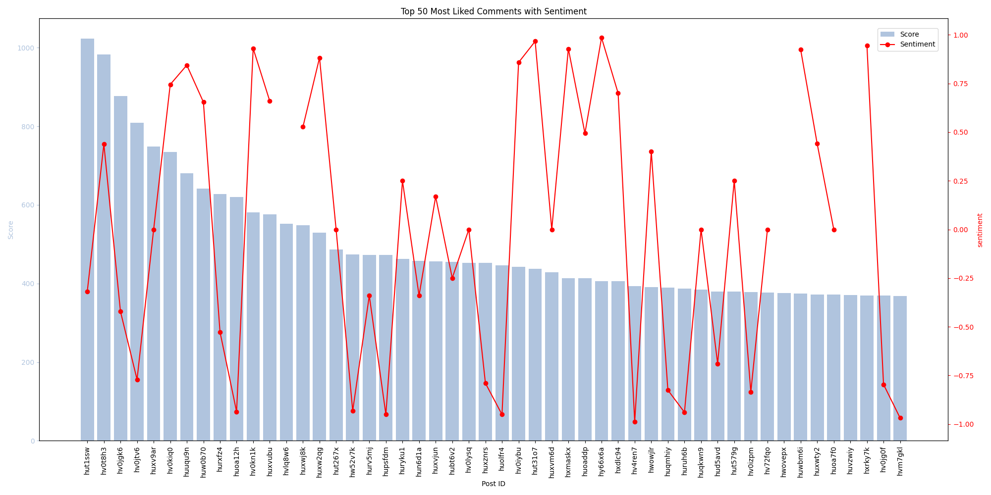
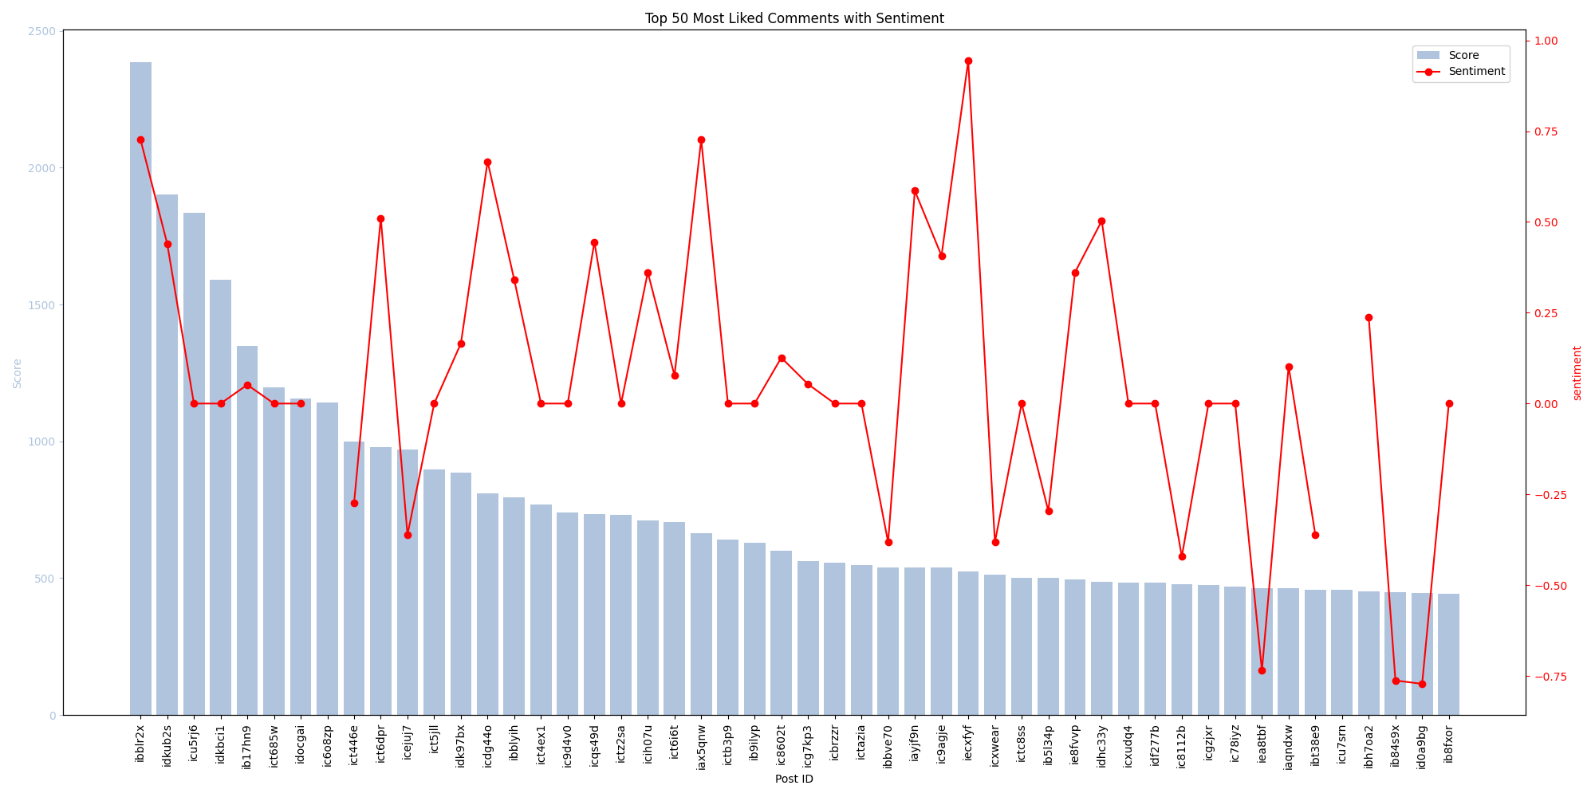
Popularity and Sentiment
Popularity of a comment and the sentiment attached to it does not have a strong correlation. Contrary to our thesis.
Graph 1 shows the most popular comments made on a Freedom Convoy subreddit and its sentiment. Correlation Coefficient= -0.044265
Graph 2 shows the most popular comments made on a Bitcoin subreddit and its sentiment. Correlation Coefficient= -0.006067
Notes:
The first set of analysis done was to try and see if there was a correlation with sentiment of a comment and its popularity.
We hypothesized that this would result with negative sentiment correlating with higher popularity.
After running the tests and performing correlation analysis we were surprised to see that across multiple data sets sentiment did not have any correlation to the popularity of the comments.
This is modeled in the two graphs provided. Both are given a data set of comments and the top 50 are shown with their sentiments displayed on the red lines.
In both cases there was no correlation with the popularity of a post.

Slide 8
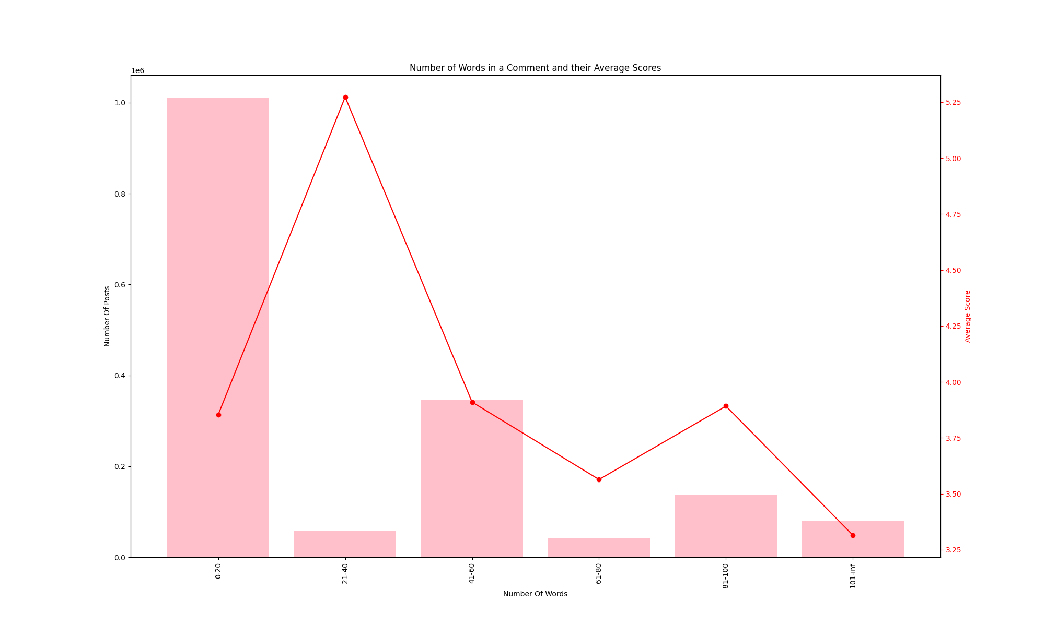
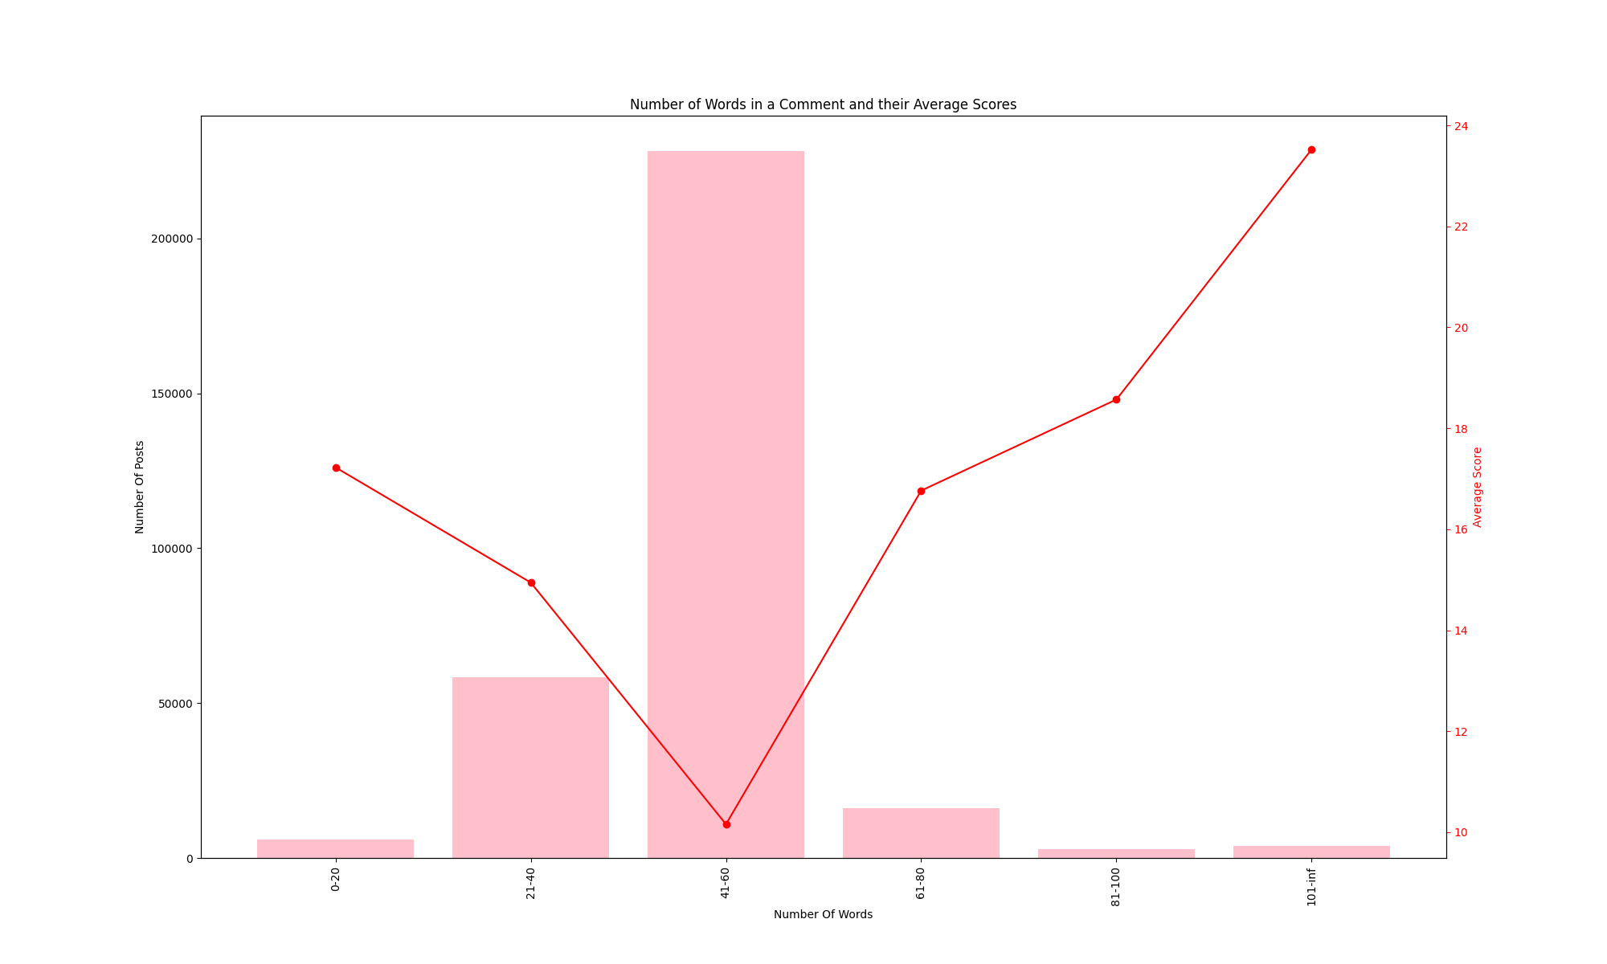
Popularity and Word count
Popularity of a comment and the number of words in the comment has an interesting trend. The number of words in a comment is generally centralized. The score varies.
Graph 1 displays the average scores for all the posts from Doge comments. Correlation coefficient = 0.0103048
Graph 2 displays the average scores for all posts from Freedom Convoy comments. Correlation coefficient = 0.1305555
Notes:
The second set of analysis done pertained to word count and popularity.
We hypothesized that this would result in shorter comments having on average a higher score.
Surprisingly, this was not the case, but an interesting trend did emerge.
Although the average scores did not correlate to a certain length of post, we did notice in all datasets of this analysis that one length subset dominated the others.
This could arguably be a case of social conformity, users on the same subreddit see others creating a certain length post and the rest follow creating a larger subset of posts with this length of comment.

Slide 9
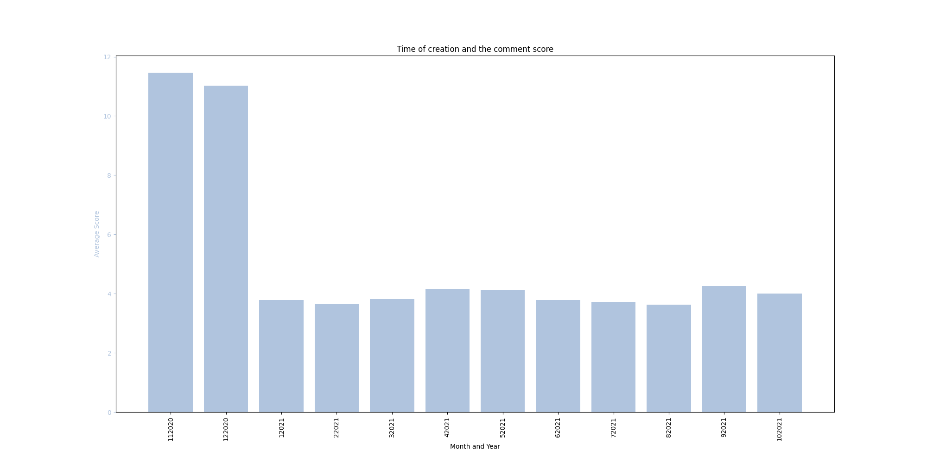
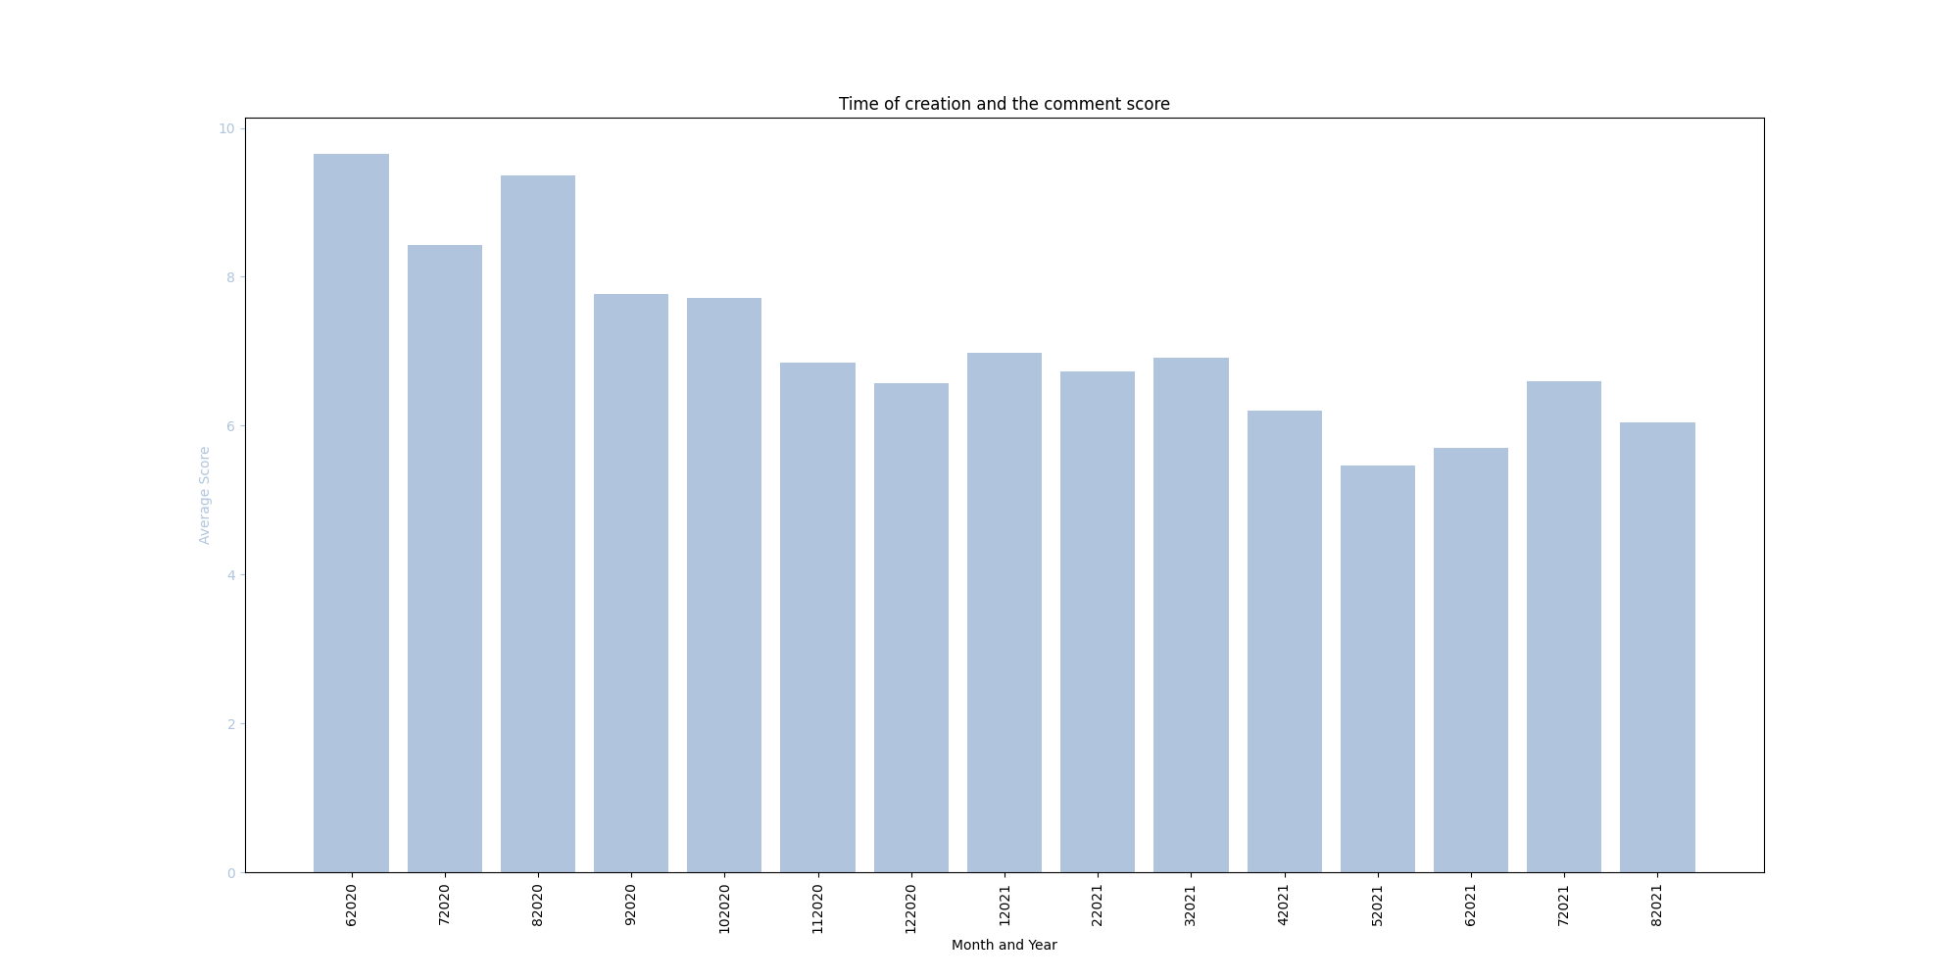
Popularity and Creation Time (Monthly)
Popularity of a comments over time shows a trend that follows our hypothesis. The number of average likes in a subreddit tends to decreased overtime.
Graph 1 Doge comments over the span on one year.
Graph 2 NoNewNormal comments over the span of 15 months.
Notes:
The next set of analysis done as based on the creation time of a comment and its popularity.
We hypothesized that over time the popularity of a topic would steadily decrease.
Our analysis supports this claim, as we can see based on two different data sets.
One containing all comments made that contain the word “Doge” and all the comments on the NoNewNormal subreddit. In both cases we see a downward trend with the average scores of all comments in each month.

Slide 10
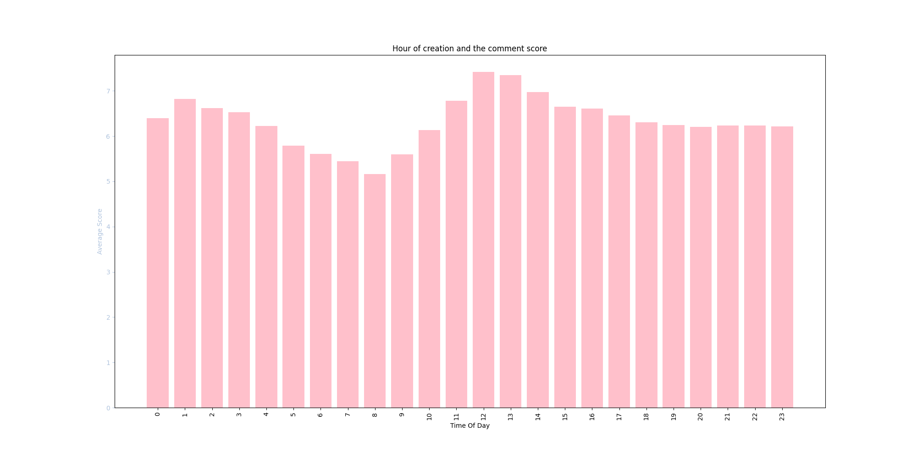
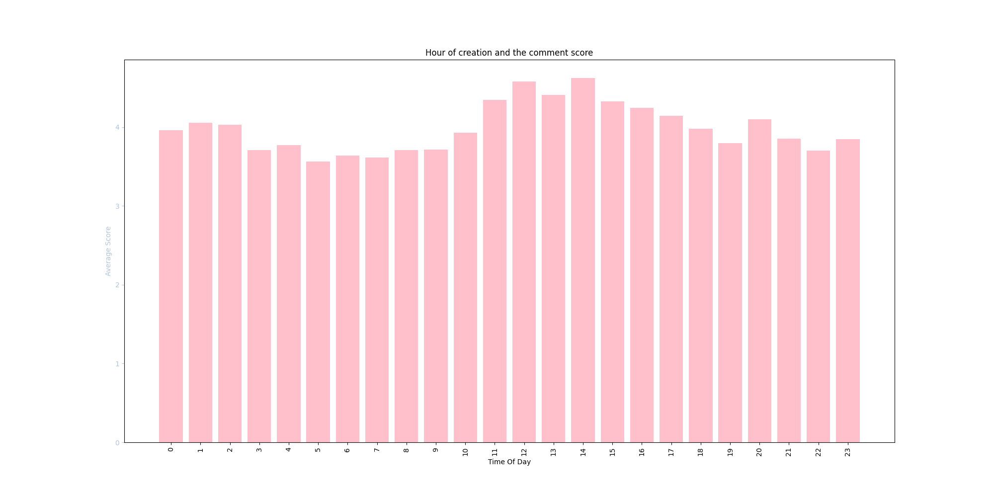
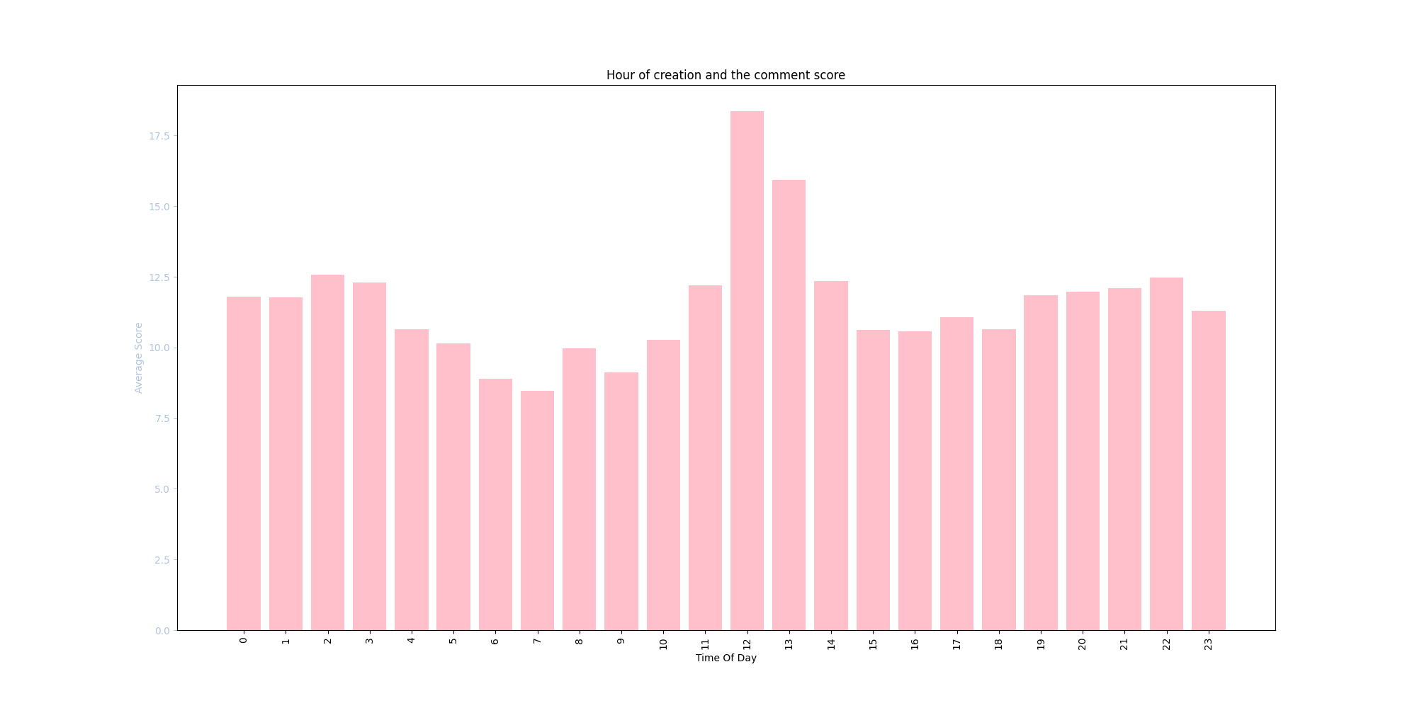
Popularity and Creation Time (Daily)
Popularity of a comment and the time of day in which it is posted has a very similar trend across multiple subreddits. Peak hours all falling around 12 while valleys occur around 8 and 16.
Graph 1 NoNewNormal subreddit and all its comment creation times vs average score.
Graph 2 Doge subreddit and all its comment creation times vs average score.
Graph 3 Trucker subreddit and all its comment creation times vs average score.
Notes:
Aside from just the overall change in popularity over time we wanted to see if the time of day a comment was made would affect its popularity. We hypothesized that there would be a trend in which the most popular house would be between work hours, mornings, breaks and after work.
The analysis done on multiple datasets came back to support out hypothesis. As we can see there is an obvious trend with popularity and time of day. We can see that comments made in the early morning, noon, and evenings, on average, do better than those posted during the normal work hours, 8-11 and 1-6.

Slide 11
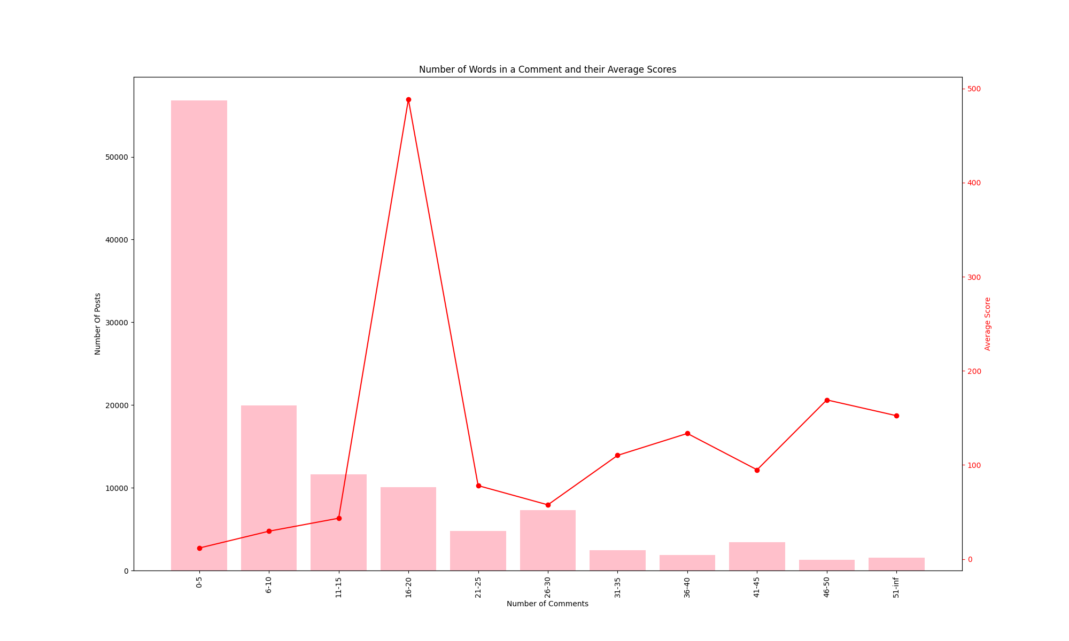
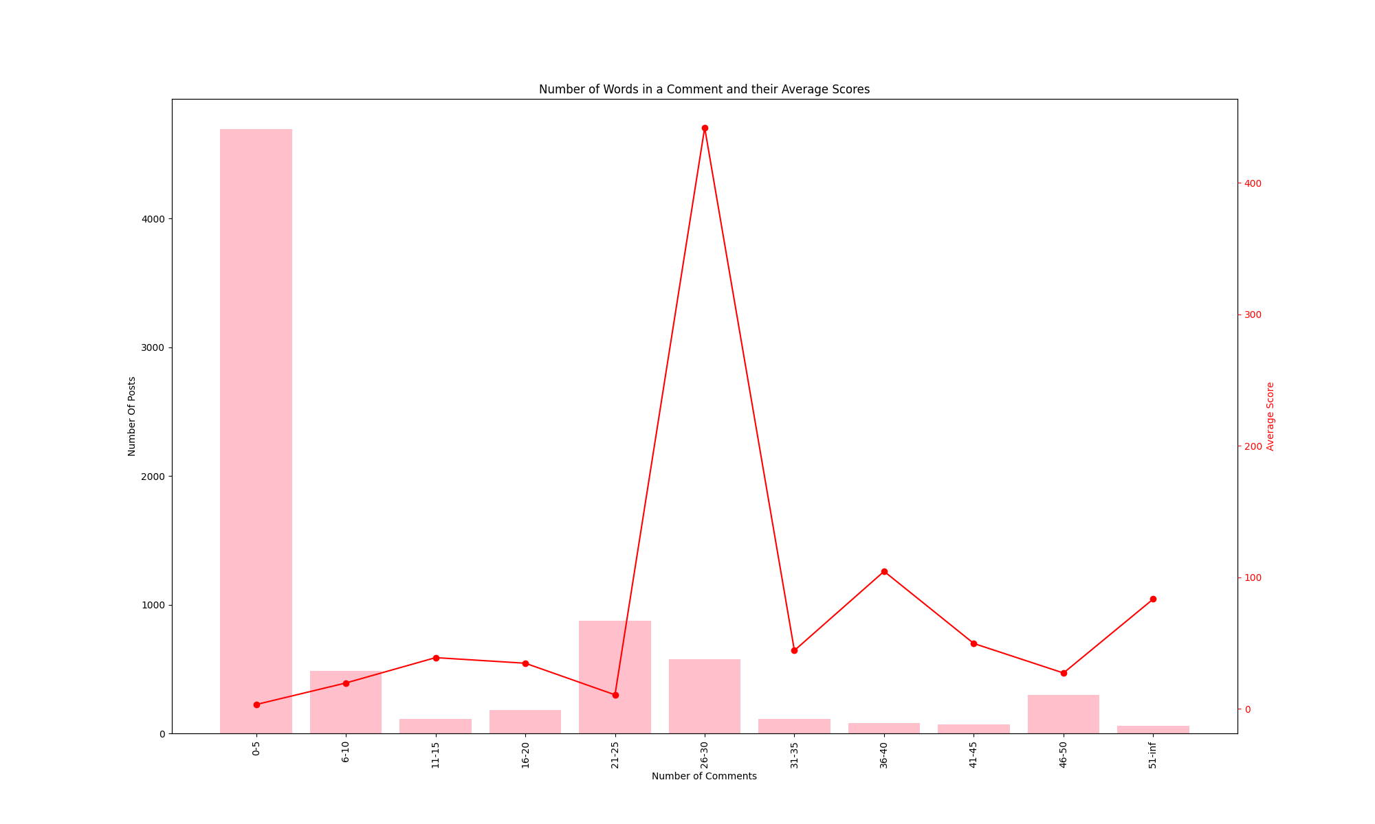
Popularity and Comments
Popularity of a post and the number of comments did not follow what we had initial hypothesized. There was an interesting trend of popularity though that showed up generality of what length is most well liked.
Graph 1 NoNewNormal posts with their respective comments and the average score.
Graph 2 BitCoin posts with their respective comments and the average score.
Notes:
Another factor we investigated that could correlate to a post’s popularity is the number of comments.
To do this we had two data sets, one containing all posts for a certain time frame and one containing all comments for a certain time frame. By mapping the posts to their respective comments, we can see an average popularity of a post grouped by the number of comments it has.
We hypothesized that more liked post would also have a higher popularity. However, based on the results this was not the case.
In all instances of running this analysis there was a trend of many posts with few comments generally have on average a lower score but the ones with the most comments did not result in an overall average high score.
There tended to be one outlier that did exceptionally well. Although it did not remain consistent throughout it tended to be somewhere in the middle of the least number of comments and the most.
This is an interesting observation because it strongly suggests that the correlation between popularity and comments is not that strong. And when it is it is not consistent.

Slide 12
The Google Natural Language API

Slide 13
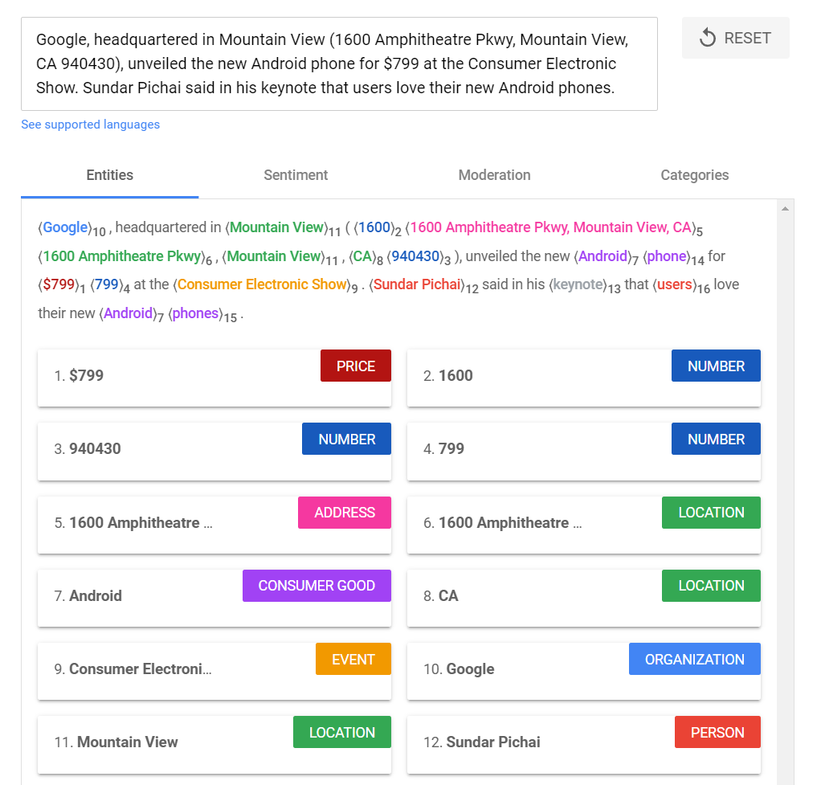
Natural Language API Overview
A set of pre-trained models often used to extract insights with natural language understanding for various applications. Features including sentiment analysis, entity analysis, entity sentiment analysis, content classification, and syntax analysis.

Slide 14
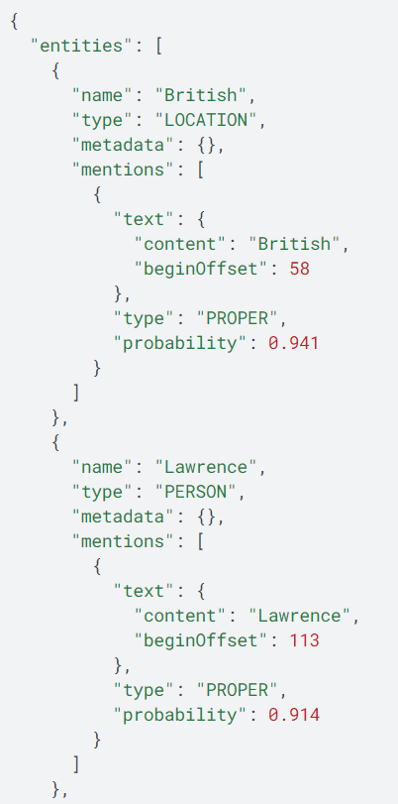
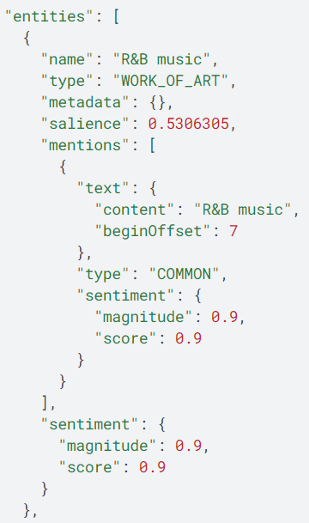
What are Entities?
Entity are words such as proper nouns such as public figures, landmarks, and so on.
Entity sentiment analysis inspects the given text for known entities (proper nouns and common nouns), returns information about those entities, and identifies the prevailing emotional opinion of the entity within the text, especially to determine a writer's attitude toward the entity as positive, negative, or neutral.
Entity Response
Entity Sentiment Response

Slide 15
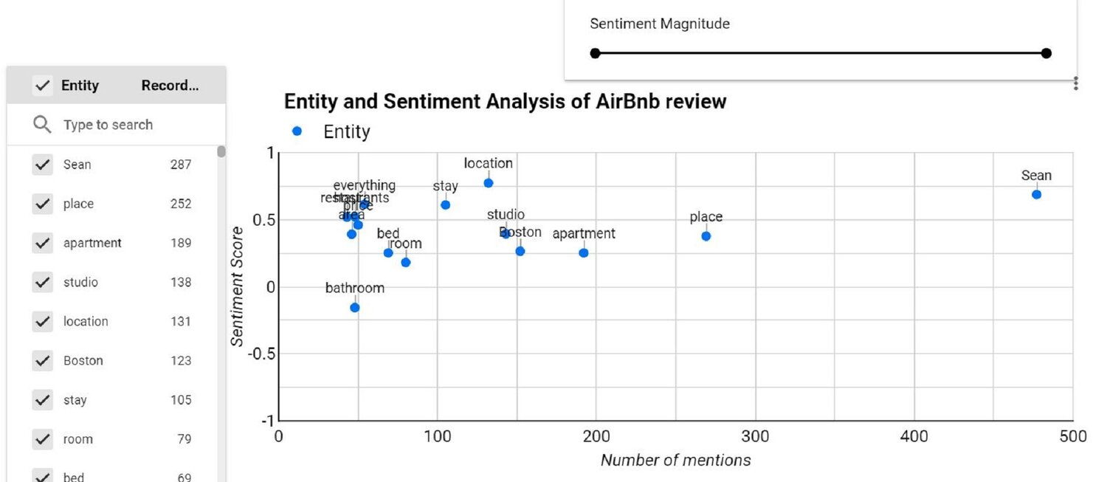
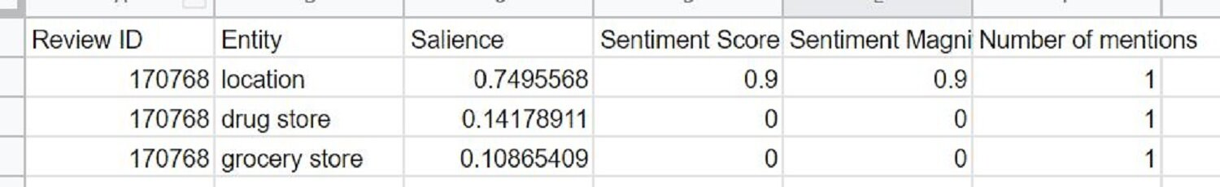
Entity and Sentiment Analysis On Website Survey Text Data Example
In this example of entity sentiment analysis, entities are plotted by:
Sentiment value along the y-axis
Entity frequency along the x-axis
In this case, a developer is analysis Airbnb review data to determine average sentiment of common entities
Clearly the bathroom needs work, however it's not an extremely common mention

Slide 16
Entity Analysis on Reddit Comments
Goal: Which words are most frequently associated with a high, moderate, and low score?
Why use Entities over simple word count? Improved relevance for textual analysis when comparing other variables (ex, score), reduces the total number of irrelevant words, entity analysis tools are pre-built by Google Cloud and ready to use.
How was the Entity Analysis Performed?
Comment data was placed into 3 separate categories or stratum based on score: low, moderate, high
Score categorization was determined by the major trend shifts on scores. Scores tend to follow a “mirrored” Power Law in the positive and negative directions as shown below.
The entity analysis was performed using a 5% - 25% sample of the comments in the high and low score categories.
From there each entity could be counted for all 3 categories and compared to determine the relative differences of entity frequencies found in the sample of comment bodies.

Slide 17
Entity Analysis on Reddit Comments
Goal: Which words are most frequently associated with a high, moderate, and low score?
Why use Entities over simple word count? Improved relevance for textual analysis when comparing other variables (ex, score), reduces the total number of irrelevant words, entity analysis tools are pre-built by Google Cloud and ready to use.
How was the Entity Analysis Performed?
Comment data was placed into 3 separate categories or stratum based on score: low, moderate, high

Slide 18
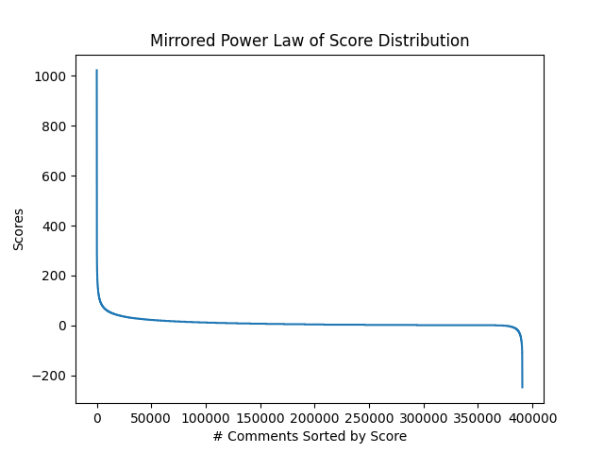
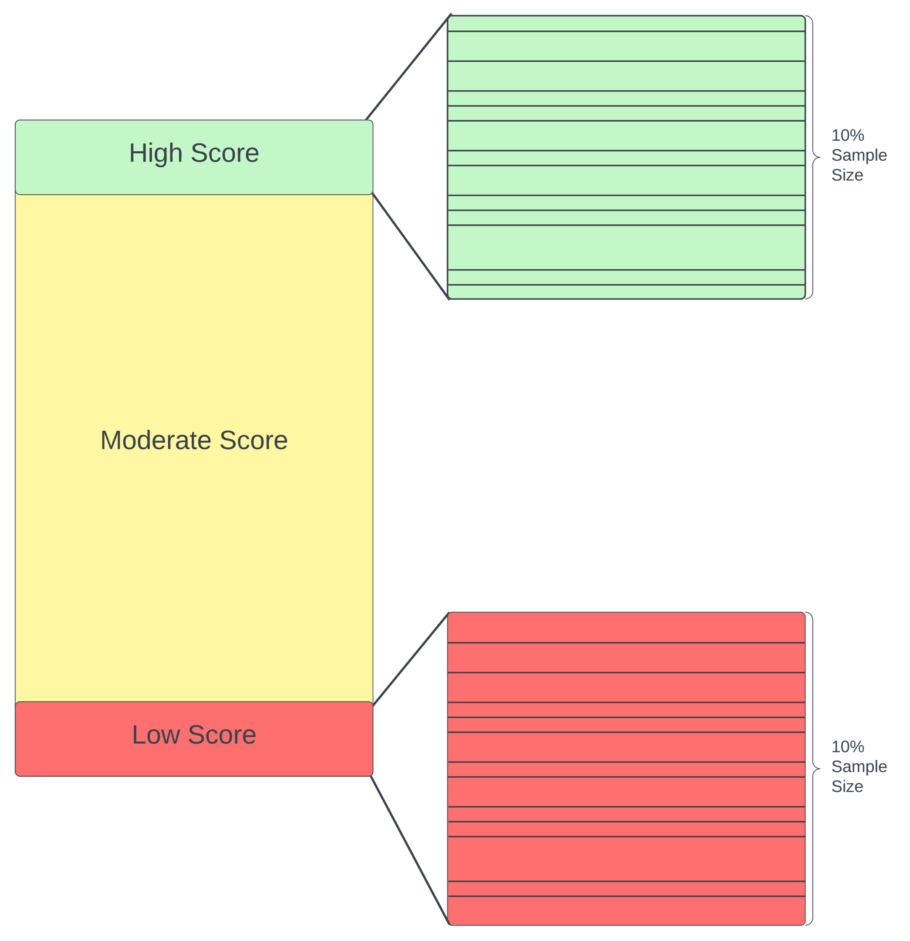
Entity Analysis on Reddit Comments
How was the Entity Analysis Performed?
Score categorization was determined by the major trend shifts on scores. Scores tend to follow a “mirrored” Power Law in the positive and negative directions as shown below.
The entity analysis was performed using a 5% - 25% sample of the comments in the high and low score categories.
From there each entity could be counted for all 3 categories and compared to determine the relative differences of entity frequencies found in the sample of comment bodies.

Slide 19
How is Entity Frequency Compared
Category examples Low Score (-254, -10) Moderate Score (-9, 20) High Score (21, 435)
Entity | High Category | Normalized | Moderate Category | Normalized | Difference
catch | 23 | 8.36% | 355 | 3.99% | 4.38
work | 28 | 10.18% | 625 | 7.02% | 3.16
hospitals | 16 | 5.82% | 295 | 3.31% | 2.51
risks | 10 | 3.64% | 115 | 1.29% | 2.34
measures | 8 | 2.91% | 69 | 0.77% | 2.13
nurses | 9 | 3.27% | 104 | 1.17% | 2.10
empathy | 6 | 2.18% | 11 | 0.12% | 2.06
antivaxxers | 9 | 3.27% | 112 | 1.26% | 2.02
vaccinations | 8 | 2.91% | 90 | 1.01% | 1.90
conspiracy | 11 | 4.00% | 192 | 2.16% | 1.84

Slide 20
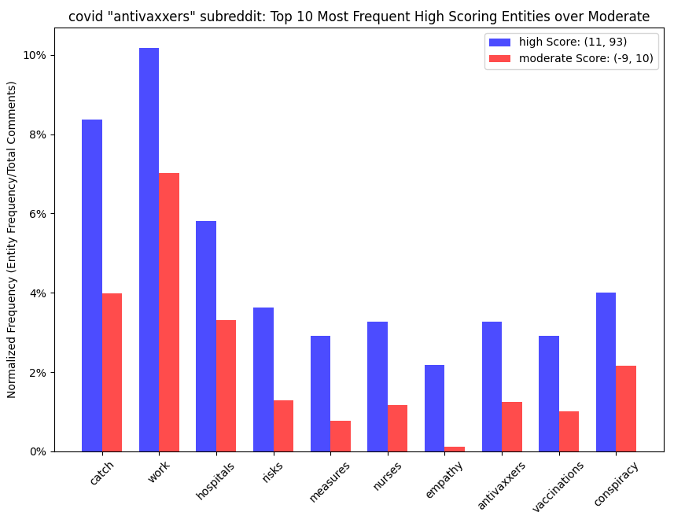
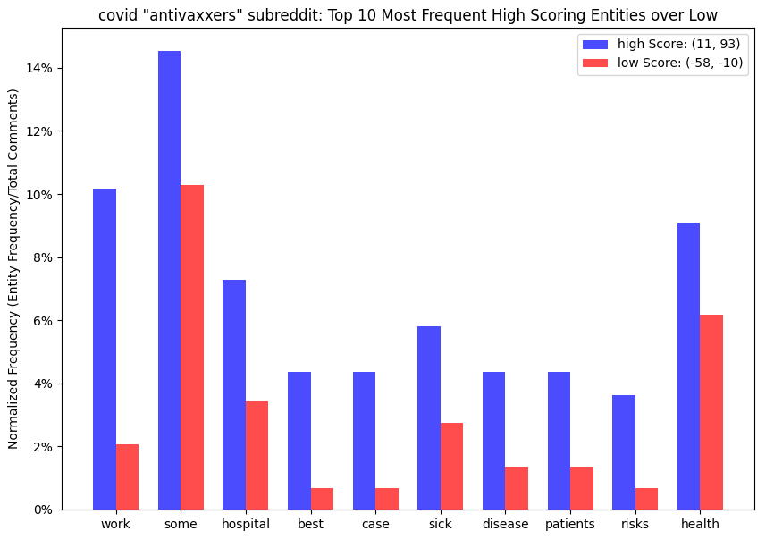
Entity | high | normalized | moderate | normalized | difference
catch | 23 | 8.36% | 355 | 3.99% | 4.38
work | 28 | 10.18% | 625 | 7.02% | 3.16
hospitals | 16 | 5.82% | 295 | 3.31% | 2.51
risks | 10 | 3.64% | 115 | 1.29% | 2.34
measures | 8 | 2.91% | 69 | 0.77% | 2.13
nurses | 9 | 3.27% | 104 | 1.17% | 2.10
empathy | 6 | 2.18% | 11 | 0.12% | 2.06
antivaxxers | 9 | 3.27% | 112 | 1.26% | 2.02
vaccinations | 8 | 2.91% | 90 | 1.01% | 1.90
conspiracy | 11 | 4.00% | 192 | 2.16% | 1.84
Entity | high | normalized | low | normalized | difference
work | 28 | 10.18% | 3 | 2.05% | 8.13
some | 40 | 14.55% | 15 | 10.27% | 4.27
hospital | 20 | 7.27% | 5 | 3.42% | 3.85
best | 12 | 4.36% | 1 | 0.68% | 3.68
case | 12 | 4.36% | 1 | 0.68% | 3.68
sick | 16 | 5.82% | 4 | 2.74% | 3.08
disease | 12 | 4.36% | 2 | 1.37% | 2.99
patients | 12 | 4.36% | 2 | 1.37% | 2.99
risks | 10 | 3.64% | 1 | 0.68% | 2.95
health | 25 | 9.09% | 9 | 6.16% | 2.93

Slide 21
High Score Entity Frequency Over Moderate
High Score Entity Frequency Over Low
Entity | High | Normalized | Moderate | Normalized | Difference
catch | 23 | 8.36% | 355 | 3.99% | 4.38
work | 28 | 10.18% | 625 | 7.02% | 3.16
hospitals | 16 | 5.82% | 295 | 3.31% | 2.51
risks | 10 | 3.64% | 115 | 1.29% | 2.34
measures | 8 | 2.91% | 69 | 0.77% | 2.13
nurses | 9 | 3.27% | 104 | 1.17% | 2.10
empathy | 6 | 2.18% | 11 | 0.12% | 2.06
antivaxxers | 9 | 3.27% | 112 | 1.26% | 2.02
vaccinations | 8 | 2.91% | 90 | 1.01% | 1.90
conspiracy | 11 | 4.00% | 192 | 2.16% | 1.84
Entity | High | Normalized | Low | Normalized | Difference
work | 28 | 10.18% | 3 | 2.05% | 8.13
some | 40 | 14.55% | 15 | 10.27% | 4.27
hospital | 20 | 7.27% | 5 | 3.42% | 3.85
best | 12 | 4.36% | 1 | 0.68% | 3.68
case | 12 | 4.36% | 1 | 0.68% | 3.68
sick | 16 | 5.82% | 4 | 2.74% | 3.08
disease | 12 | 4.36% | 2 | 1.37% | 2.99
patients | 12 | 4.36% | 2 | 1.37% | 2.99
risks | 10 | 3.64% | 1 | 0.68% | 2.95
health | 25 | 9.09% | 9 | 6.16% | 2.93
Moderate Score Entity Frequency Over High
Low Score Entity Frequency Over High
Entity | High | Normalized | Moderate | Normalized | Difference
vaccine | 116 | 42.18% | 5277 | 59.26% | -17.08
people | 157 | 57.09% | 6424 | 72.14% | -15.05
all | 59 | 21.45% | 2794 | 31.38% | -9.92
like | 56 | 20.36% | 2682 | 30.12% | -9.75
more | 51 | 18.55% | 2482 | 27.87% | -9.33
one | 30 | 10.91% | 1731 | 19.44% | -8.53
will | 53 | 19.27% | 2454 | 27.56% | -8.28
any | 28 | 10.18% | 1343 | 15.08% | -4.90
same | 13 | 4.73% | 843 | 9.47% | -4.74
symptoms | 1 | 0.36% | 443 | 4.97% | -4.61
Entity | High | Normalized | Low | Normalized | Difference
all | 59 | 21.45% | 53 | 36.30% | -14.85
vaccine | 116 | 42.18% | 82 | 56.16% | -13.98
will | 53 | 19.27% | 45 | 30.82% | -11.55
like | 56 | 20.36% | 42 | 28.77% | -8.40
term | 9 | 3.27% | 16 | 10.96% | -7.69
many | 28 | 10.18% | 26 | 17.81% | -7.63
flu | 12 | 4.36% | 17 | 11.64% | -7.28
people | 157 | 57.09% | 93 | 63.70% | -6.61
covid | 144 | 52.36% | 85 | 58.22% | -5.86
need | 26 | 9.45% | 22 | 15.07% | -5.61
Here ‘vaccine’ and generic 3 to 4 letter words are associated with a moderate score
Here ‘vaccine’ and generic 3 to 4 letter words are associated with a low score

Slide 22
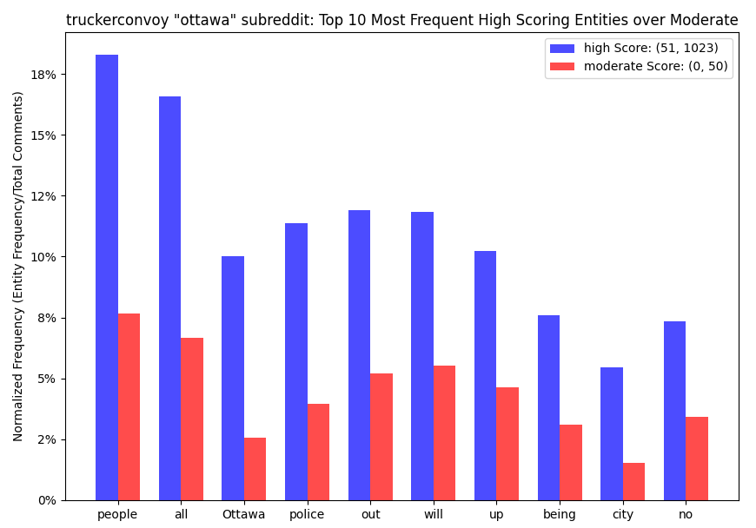
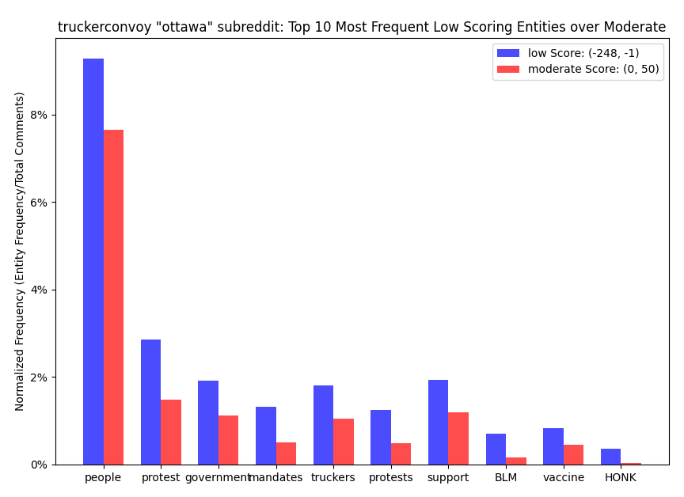

Slide 23
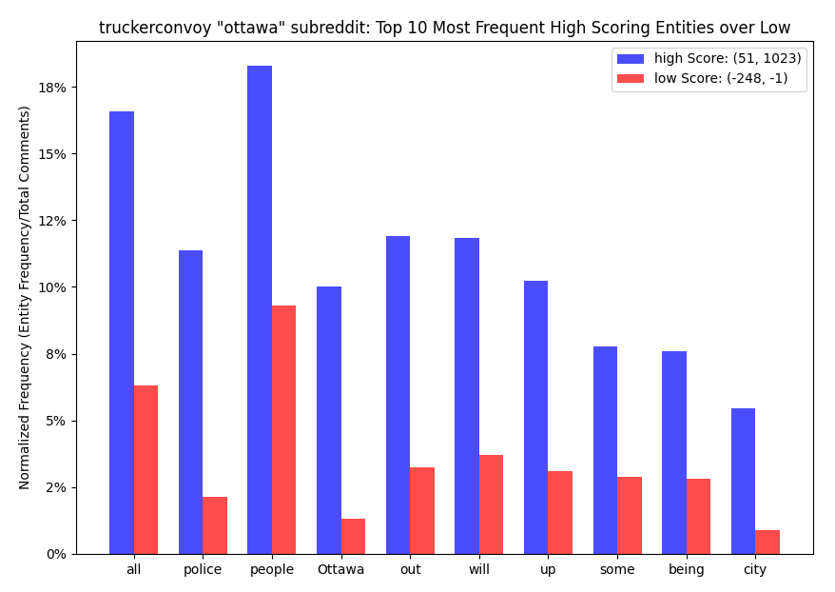
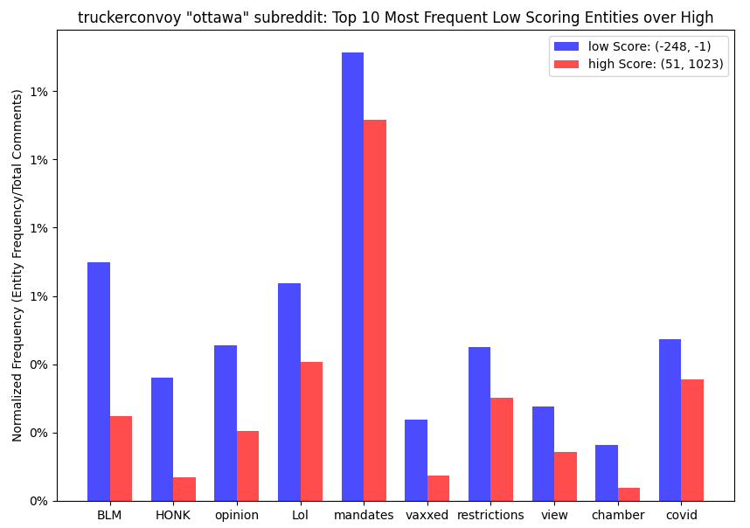

Slide 24
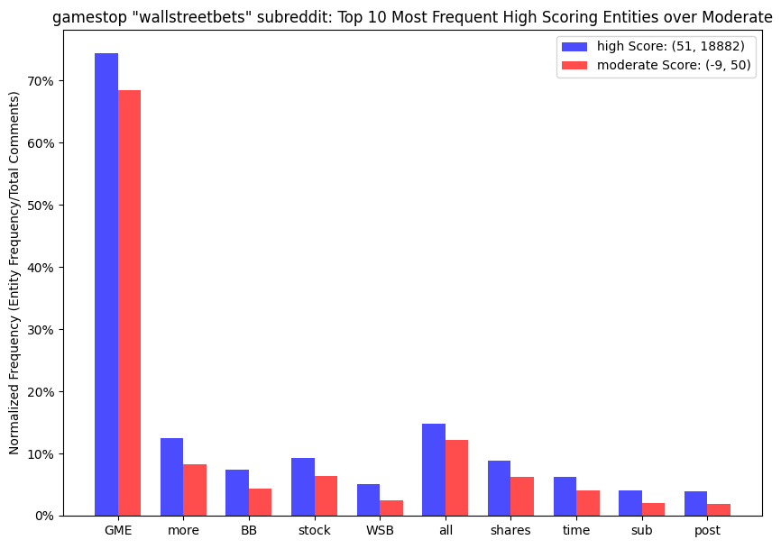
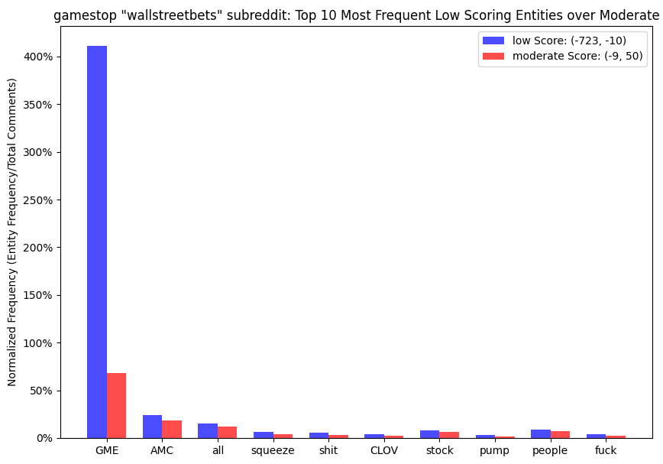

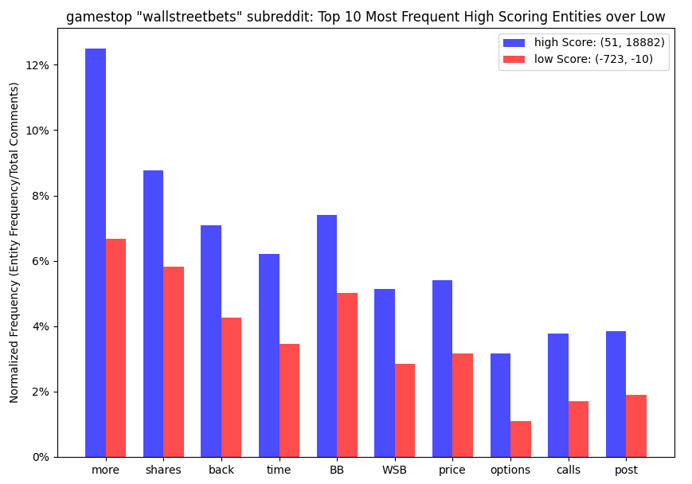
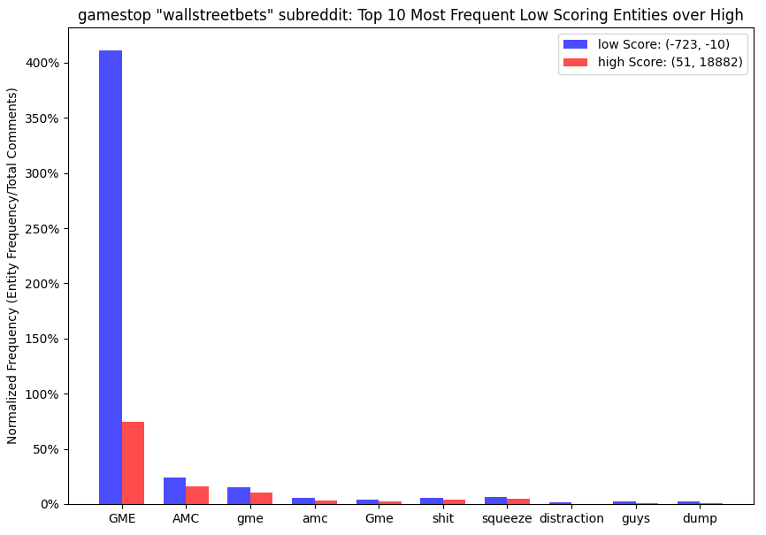


Slide 25
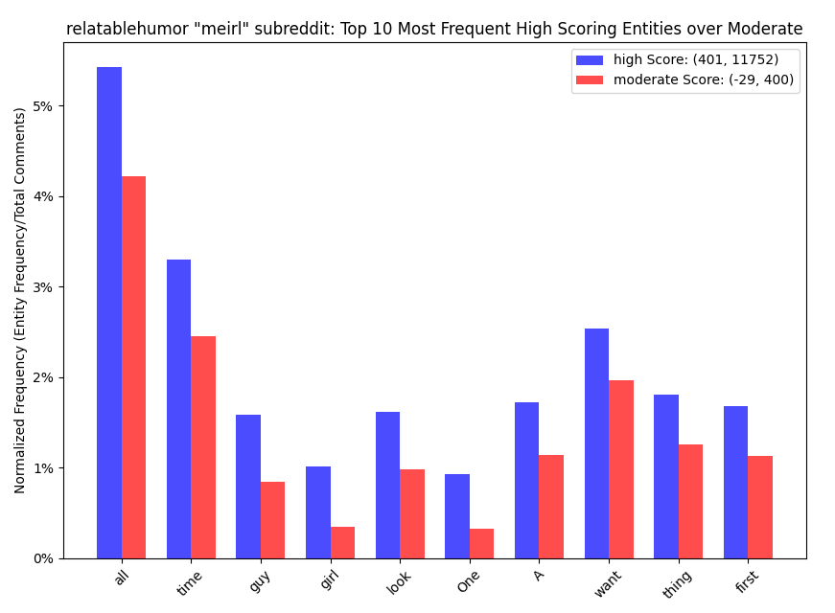
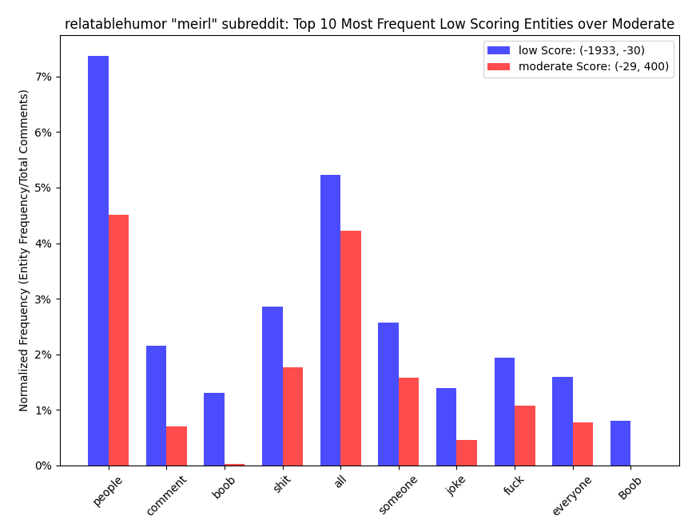

Slide 26
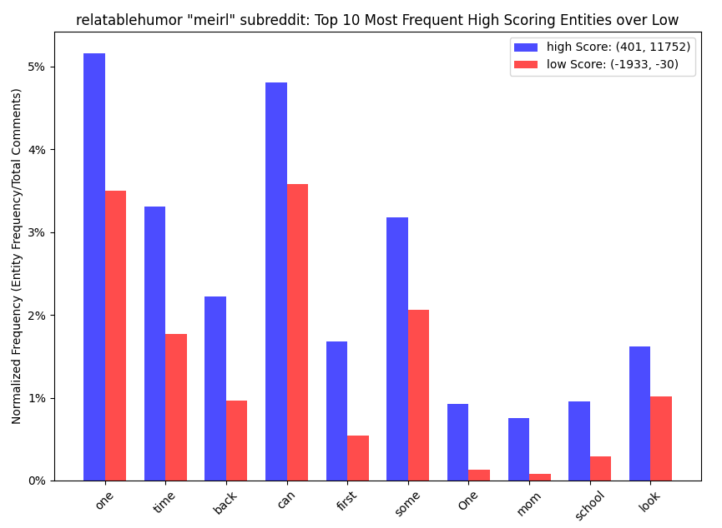
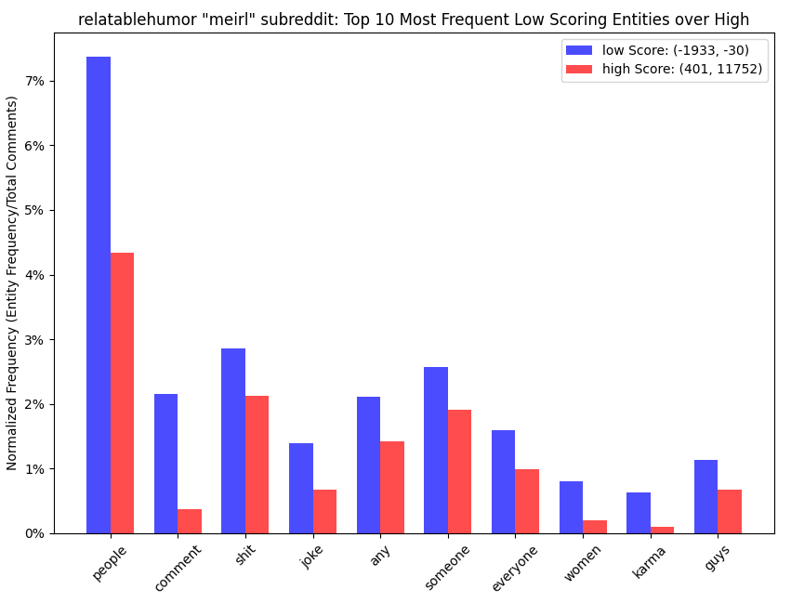

Slide 27

Conclusions
Popularity and Sentiment
No correlation
Popularity and Word Count
No correlation
Found a trend pertaining to social conformity
Popularity and Creation Time (Month)
Over time the average popularity of a topic has a downward trend.
Popularity and Creation Time (Daily)
Time of creation remain relatively consistent in what will gain greater popularity.
Popularity and Comments
Found a trend pertaining to the most liked posts on average are the ones that are “medium” length.
Popularity and Entity Frequency
In some cases, a correlation with entity frequency and score was found based on the stratum, for example the ‘antivaxxers’ subreddit
Many times, spamming its not favored such as the entity “GME” in the ‘r/Wallstreetbets’ dataset.
Clearly profanity is negatively correlated with score in half of the studied subreddits
Notes:
In conclusion we found some interesting insights into popularity on reddit. Some of our hypothesis such as those related to time were fairly accurate when using our data sets. Furthermore, we found some trends with word count and comments that we did not anticipate such as the trend pertaining to social conformity and the nonuniform popularity spikes when it came to the number of comments in a post.
The main let down was the sentiment analysis, there was little to no correlation for multiple data sets and we did not see any outlying trends within the analysis.

Slide 28
Challenges & Issues
Data sets
Post data text bodies were missing.
Large dataset sizes proved be slow with standard python algorithms. The appropriate use of Pandas vectorized DataFrame operations were required.
Cloud and AI tools
Google Cloud offer exceptional products, however costs become considerably high with large datasets and in-depth study.
Sampling data was required (due to costs) which resulted in only 5% to 25% of total entities being analyzed.
Entity Frequency
Calculating entity frequency proved to be challenging due balancing cost constraints and accuracy when dealing with large datasets.
Entity frequency does not paint the entire picture of entity correlations with score.
Provides little context into the reason for word frequency relative to other stratums.
Only offers a broad view of a subreddits dominant conversation.

Slide 29
Improvements
Data sets
Searching for larger and more complete data sets would yield more accurate results and make analysis easier to perform.
Searching for a high quantity of data sets across more diverse subreddits.
Cloud and AI tools
An in depth look into more advanced Google AI language tools
Advanced generative LLM’s may be fruitful in providing added context to text data.
Investigate other platforms besides Google that may offer tailored and/or cheaper tools for textual analysis relative to score.
Google Natural Language API
Begin by using the natural language API instead of building custom tools first.
Look into entity sentiment relative to score in addition to entity frequency.

Slide 30
Questions?

